Slide 1
Analyze stock prices using regression, classification, and time series analysis
Yifan Yang
yf990925@gmail.com
18909270788

Slide 2
TABLE OF CONTENTS
Introduction
01
Methodology
02
Papers and Applications
03
Questions and Answers and Assignments
04
SECTION TITLE | 2
SECTION TITLE | 2

Slide 3

https://rayford295.github.io/

Slide 4
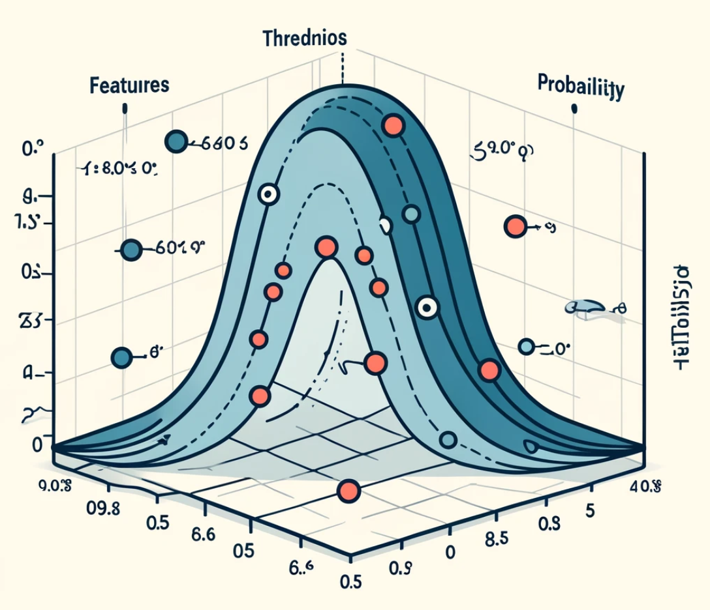
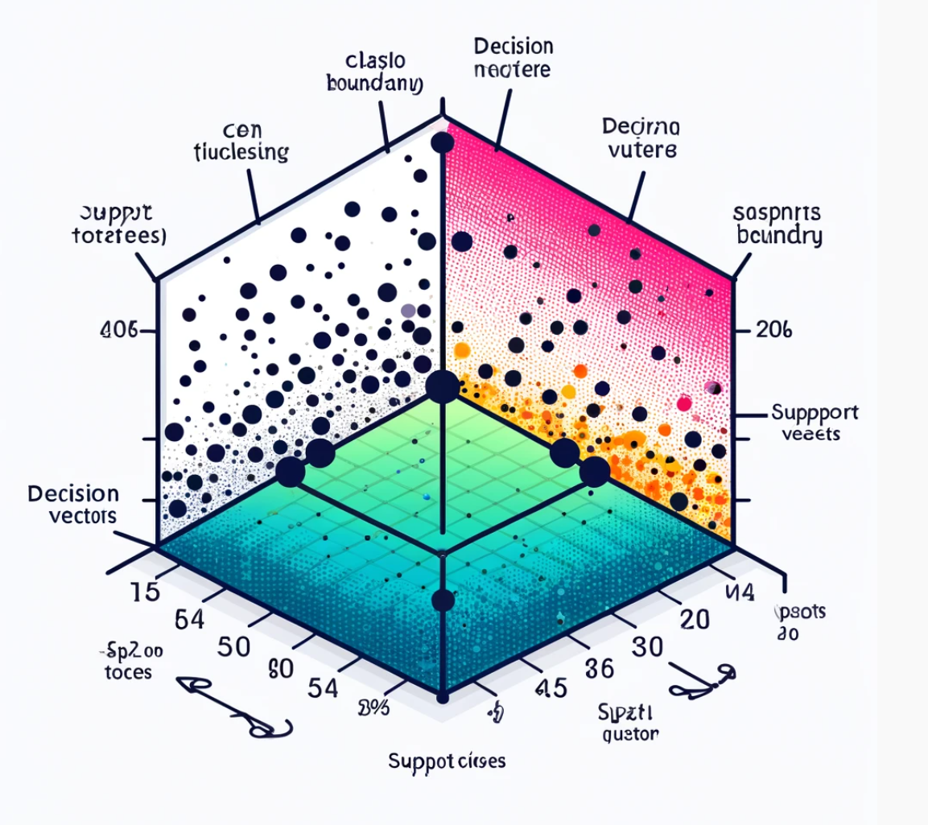

Slide 5
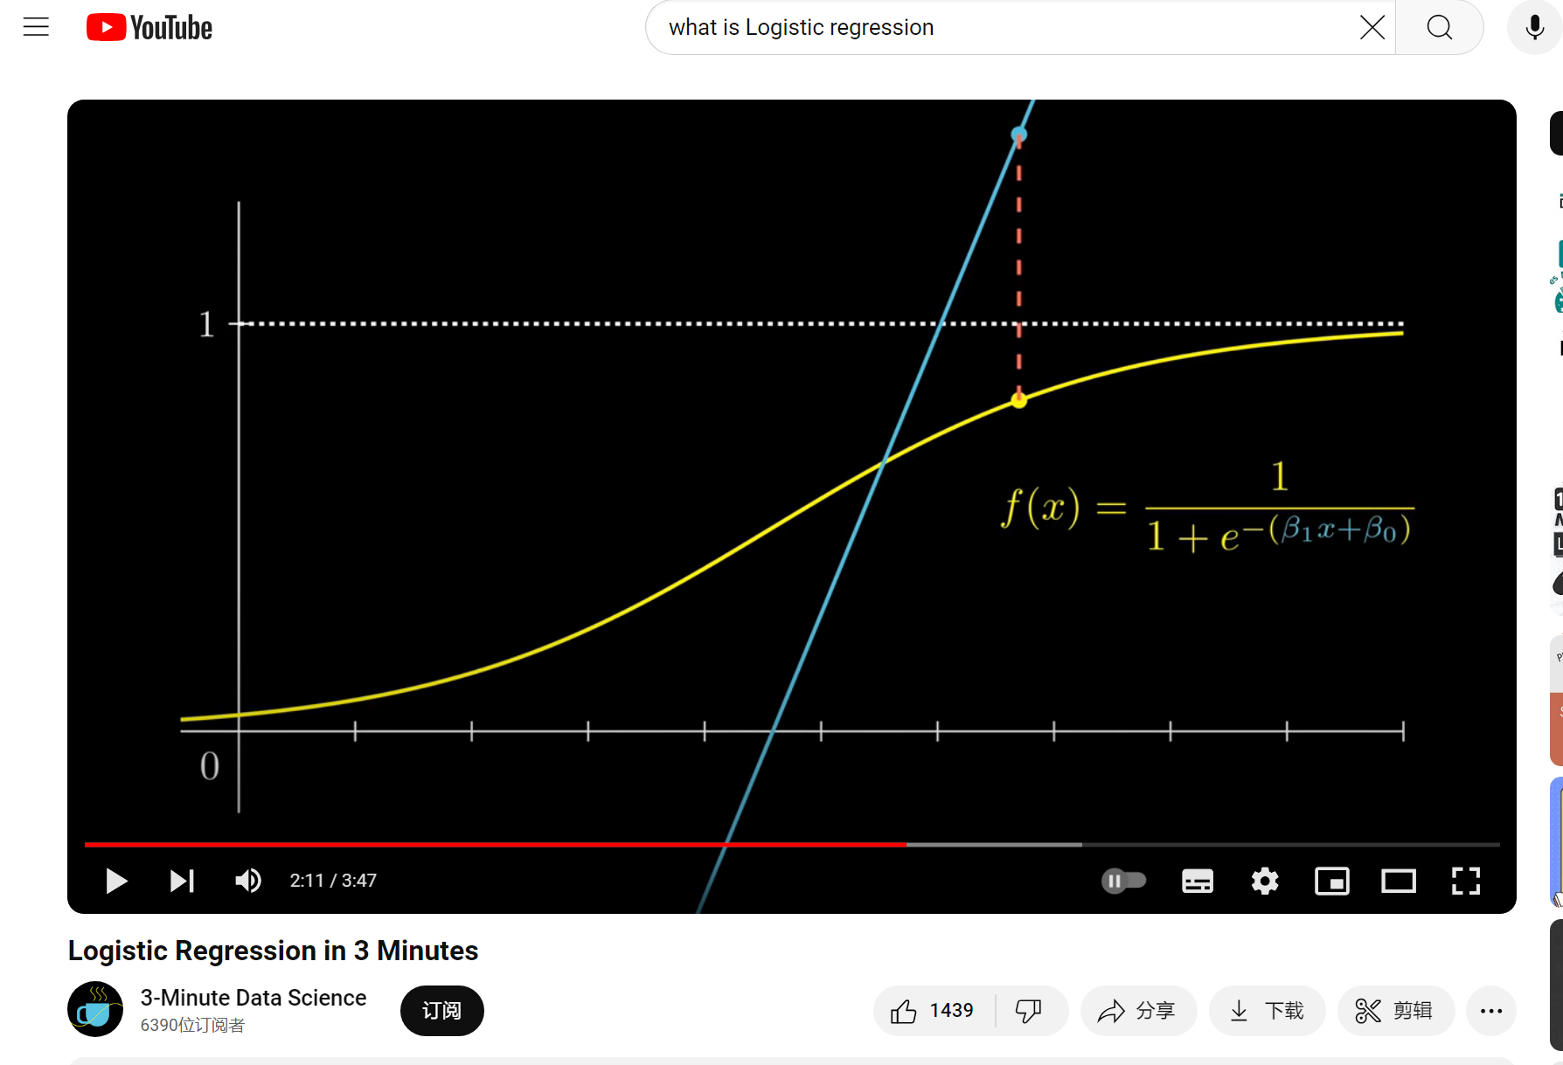
https://www.youtube.com/watch?v=EKm0spFxFG4

Slide 6
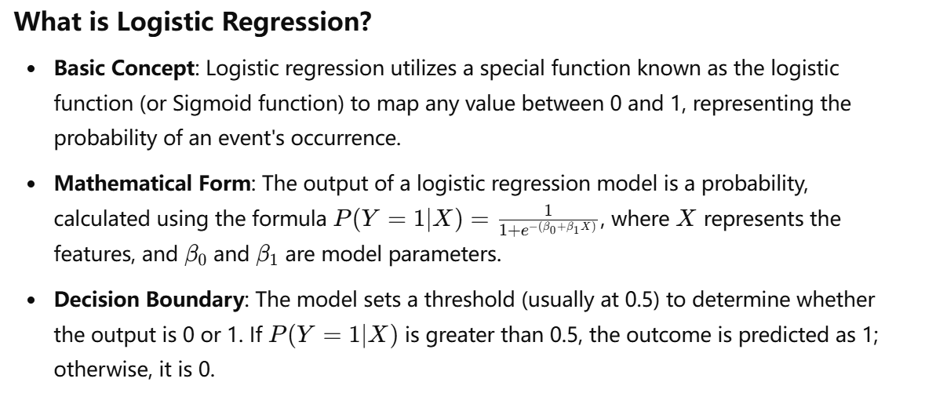
Logistic regression is a widely used statistical method for binary classification problems, effectively predicting the likelihood of an event occurring. It is particularly well-suited for scenarios where the outcome needs to be predicted as either "yes" or "no" based on a set of input variables.

Slide 7
Application of Logistic Regression in Stock Price Prediction
Logistic regression is a statistical learning method mainly used to deal with binary classification problems. It determines the probability of a sample belonging to a certain category by predicting the probability of the output result using a logistic function (usually a Sigmoid function).
Application steps:
Data preparation: Select features that affect the rise and fall of stock prices, such as price changes and trading volume of the previous day.
Feature selection: Select influential features based on statistical tests and business understanding.
Model training: Use the selected features to train the data through a logistic regression model. The model will learn the relationship between features and stock price rise and fall.
Model evaluation: Evaluate model performance through indicators such as accuracy, recall, and F1 score.

Slide 8
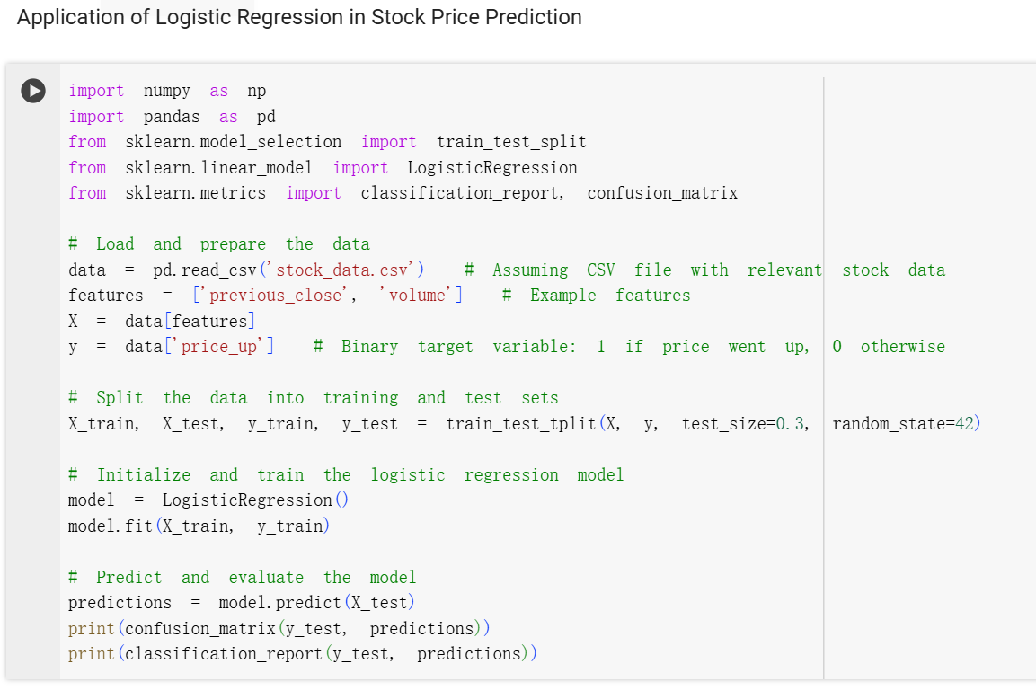

Slide 9
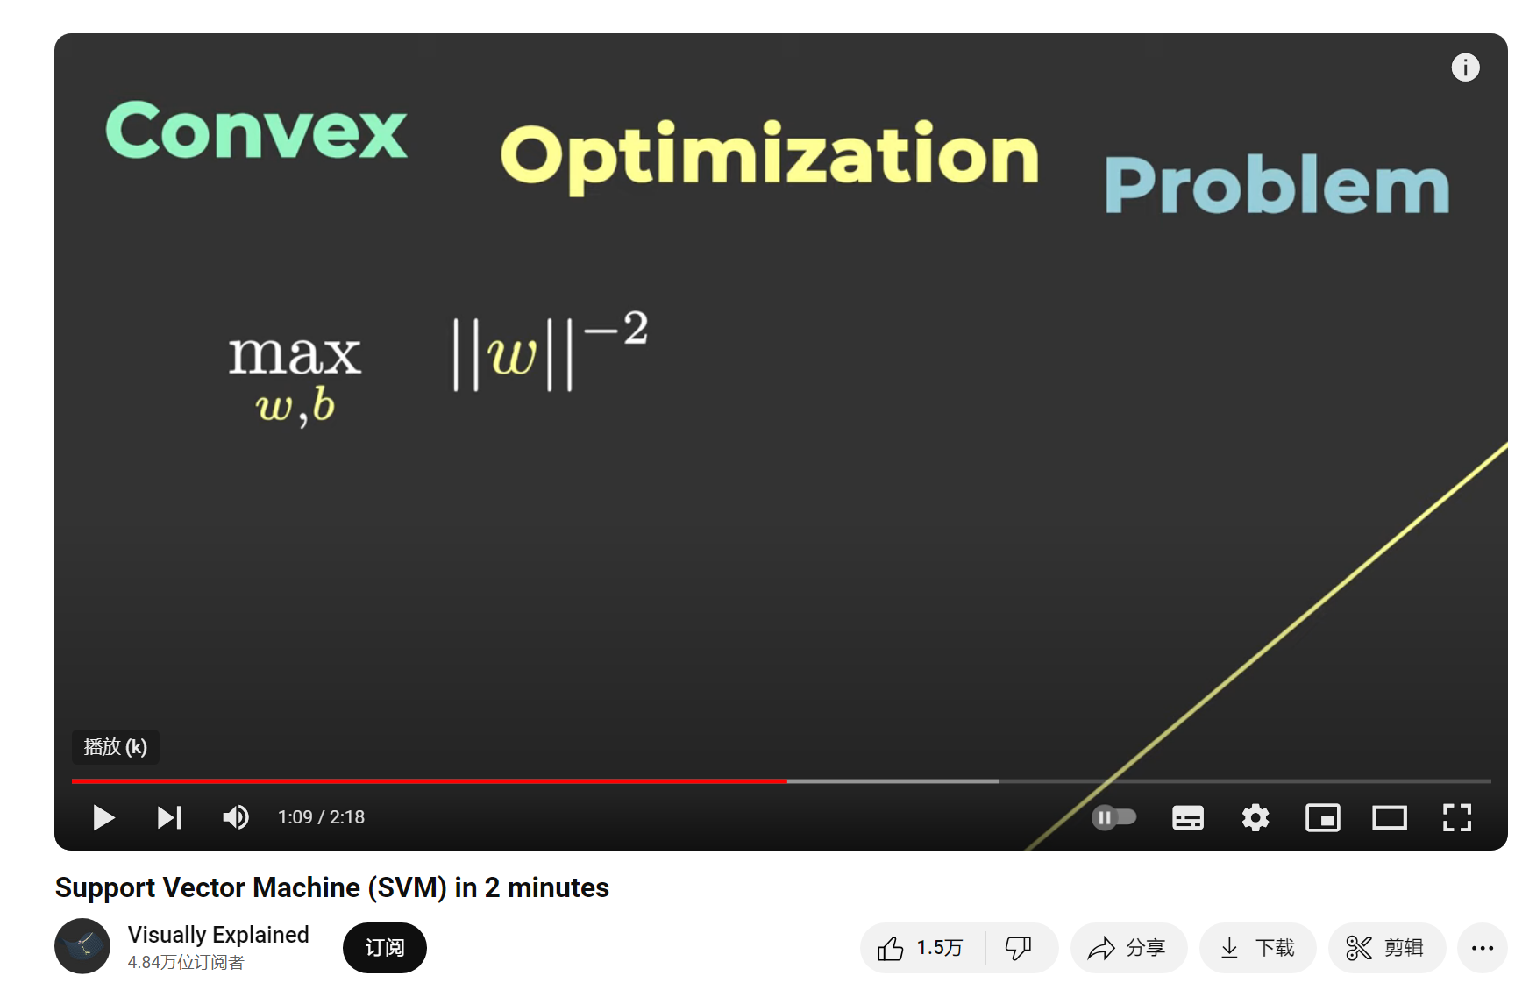
https://www.youtube.com/watch?v=_YPScrckx28

Slide 10
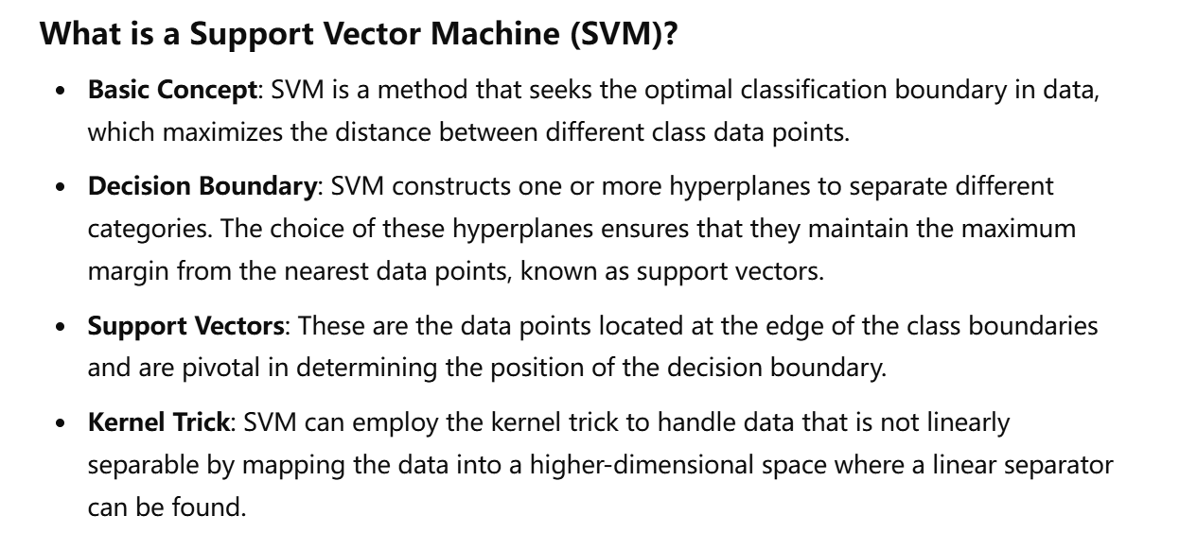
Support Vector Machine (SVM) is a powerful supervised learning model used for both classification and regression tasks.

Slide 11
Application of Support Vector Machine (SVM) in Stock Price Prediction
Support vector machine is a powerful classification algorithm that finds an optimal boundary in the data to maximize the distinction between different categories. SVM performs particularly well for nonlinear problems because it can use kernel techniques to handle data that is inseparable in the original space.
Application steps:
Data preparation: Similarly, it is necessary to select and process the feature data that affects stock prices.
Select kernel function: Select a suitable kernel function according to the characteristics of the data, such as linear kernel, polynomial kernel or radial basis function (RBF) kernel.
Model training: Use the SVM algorithm to train the model and find the optimal dividing boundary.
Model evaluation: Use methods such as cross-validation to evaluate the performance of the SVM model.
Result application: Use the prediction results of the SVM model to guide stock buying and selling decisions.

Slide 12
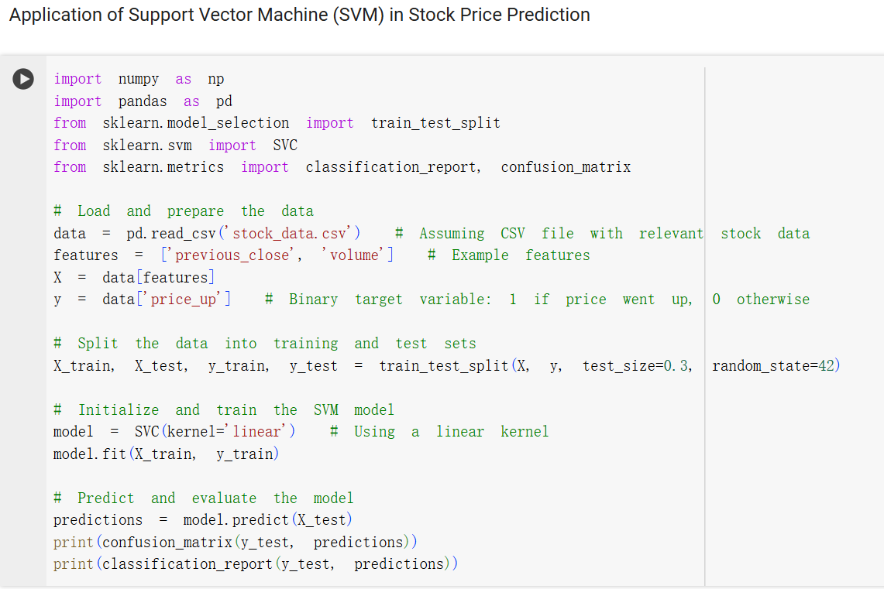

Slide 13
Stock Price Forecasting Using Data From Yahoo Finance and
Analysing Seasonal and Nonseasonal Trend
Jagwani, J., Gupta, M., Sachdeva, H., & Singhal, A. (2018, June). Stock price forecasting using data from Yahoo finance and analysing seasonal and nonseasonal trend. In 2018 Second international conference on intelligent computing and control systems (ICICCS) (pp. 462-467). IEEE.
1. These issues generally increase the dependency of stock price prediction on them rather than focusing primarily on the actual prices of stocks. Therefore, Time series analysis is the most optimal solution to the problem.
2. Time series analysis eliminates the dependency of one factor on another in the forecast. Various techniques of time series analysis are used to forecast stock prices. Time series and the idea of ​​decomposition model is proposed.

Slide 14
Q1: How to use linear regression model to predict future stock prices?
Q2: How is classification model used in stock market prediction?
Q3: What is the role of time series analysis in stock price prediction?
anything other questions and group discussion

Slide 15
Q1: How to use linear regression model to predict future stock prices?
A1: Linear regression model predicts future prices by analyzing the relationship between historical stock prices and other influencing factors (such as trading volume, economic indicators, etc.). First, it is necessary to collect and process historical data, then select appropriate features for regression analysis, and use the established model to predict the stock price at a certain point in the future.
Q2: How is the classification model applied in stock market prediction?
A2: Classification models are mainly used in stock market prediction to predict the trend of stock prices, that is, whether the stock price will rise or fall. By analyzing the historical data of stocks and other relevant factors such as technical indicators and market sentiment, the model can predict whether the stock will appreciate or depreciate in the future. Commonly used classification algorithms include logistic regression, decision trees, and support vector machines.
Q3: What is the role of time series analysis in stock price prediction?
A3: Time series analysis focuses on analyzing the sequence of data points changing over time. It is very useful in stock price prediction because it can help analyze and predict the time trend and cyclical fluctuations of stock prices. Commonly used time series models include ARIMA and Long Short-Term Memory (LSTM) networks, which are able to handle the nonlinear characteristics and long-term dependencies of stock price data and thus provide more accurate forecasts.

